Slide 1
MASTERING SPREADSHEET
S2 BCOM

Slide 2
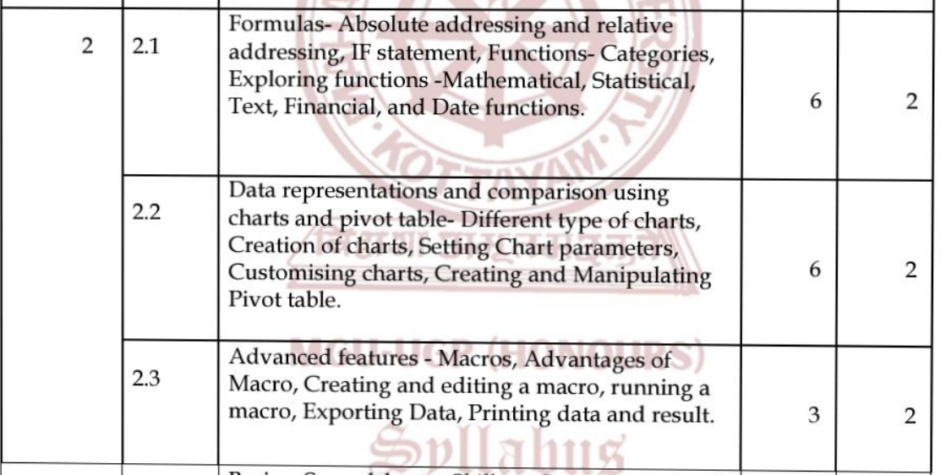

Slide 3
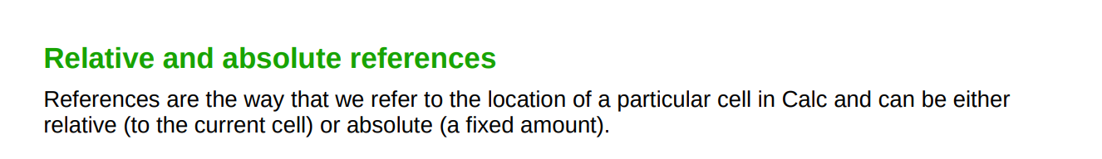
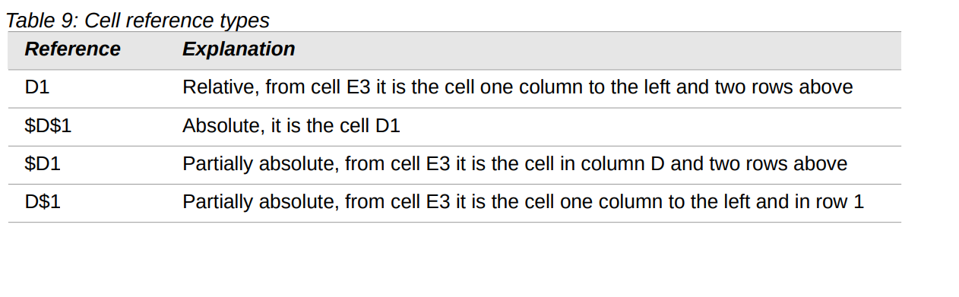

Slide 4
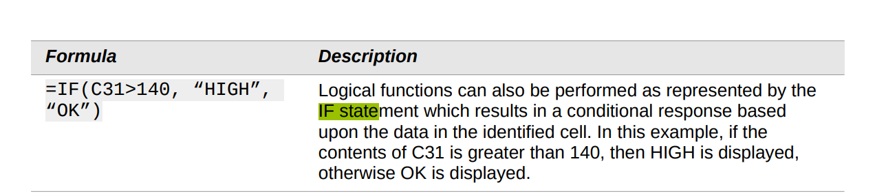
IF STATEMENT

Slide 5
UNDERSTANDING FUNCTIONS
Calc includes over 500 functions to help you analyze and reference data.
Many of these functions are for use with numbers, but others are used with dates and times or even text.
A function may be as simple as adding two numbers together or finding the average of a list of numbers, or it may be as complex as calculating the standard deviation of a sample or a hyperbolic tangent of a number.

Slide 6
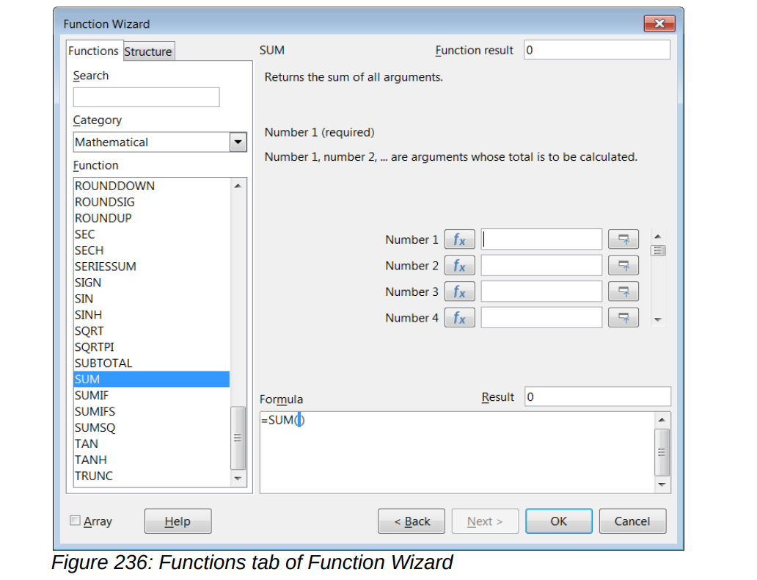
To open it, choose Insert > Function, or click the Function Wizard icon on the Formula Bar, or press Ctrl+F2.

Slide 7
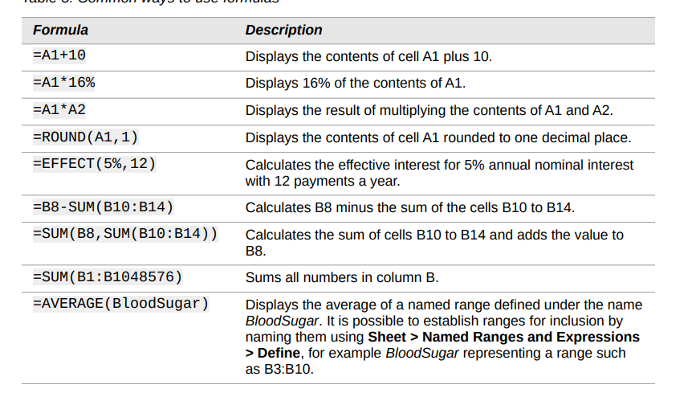

Slide 8
MATHEMATICAL FUNCTIONS
The following mathematical functions are mainly used in business applications
SUM
SUMIF
ROUND
ROUNDUP
ROUNDDOWN

Slide 9
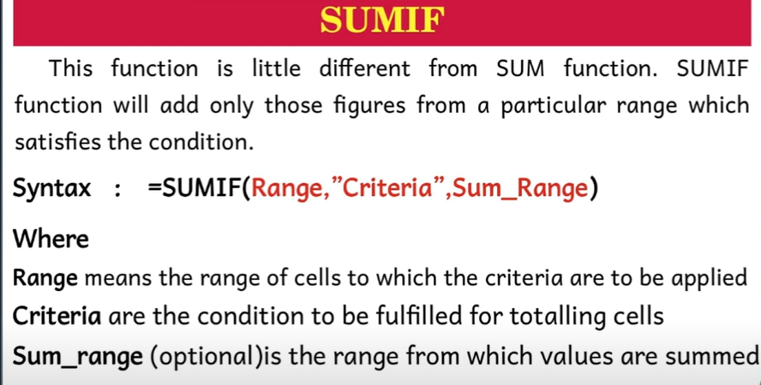

Slide 10
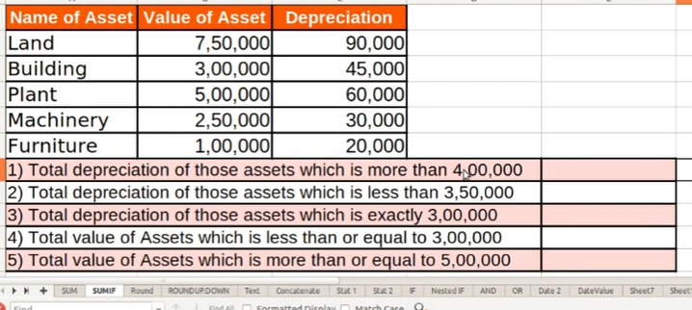
SUMIF FUNCTION
=SUMIF(data_to_test;”>0”;data_to_sum)

Slide 11
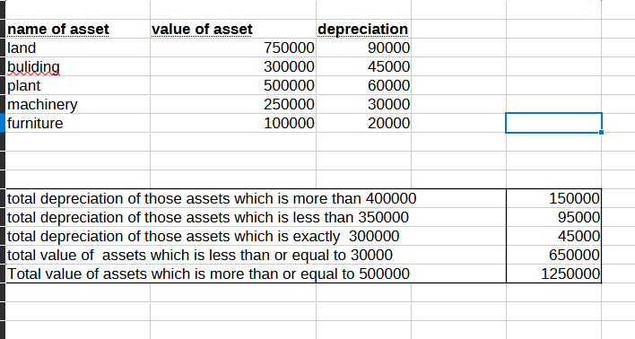
=SUMIF(B3:B7,">400000",C3:C7)
=SUMIF(B3:B7,“<350000",C3:C7)
=SUMIF(B3:B7,“=300000 ",C3:C7)
=SUMIF(B3:B7,“<=300000 ",B3:B7)
=SUMIF(B3:B7,">=500000 “)

Slide 12
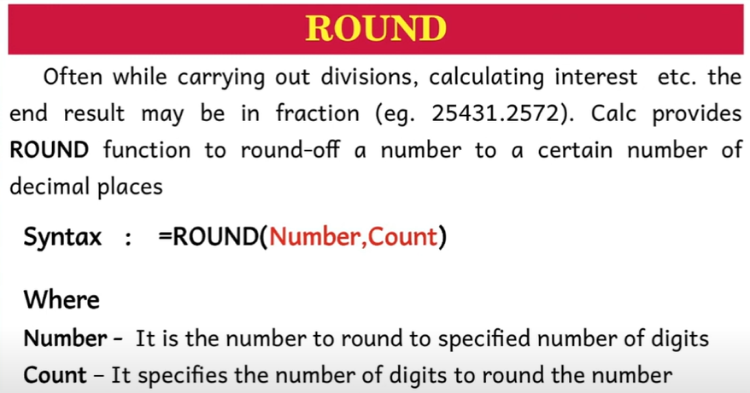
For instance, the formula =ROUND((SUM(A1,A2))

Slide 13
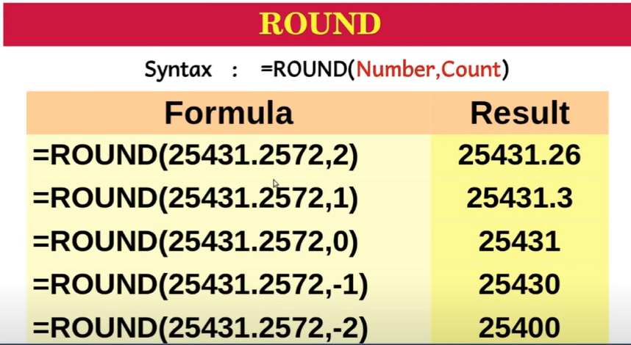

Slide 14
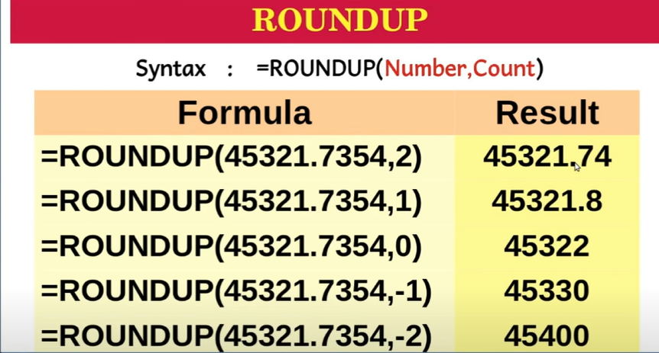

Slide 15
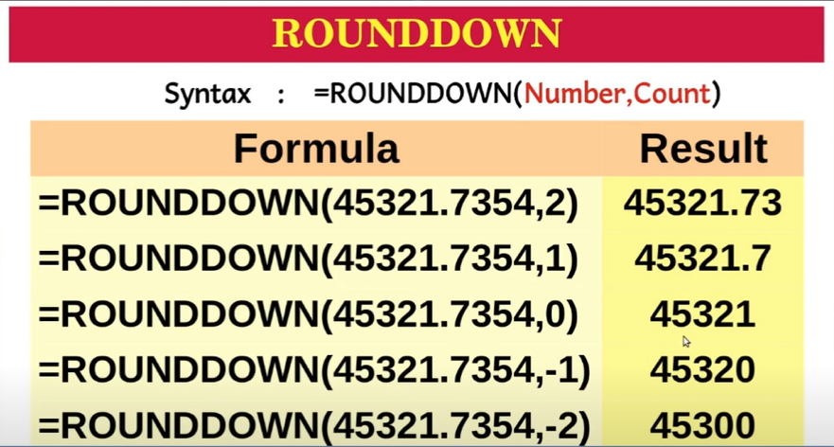

Slide 16
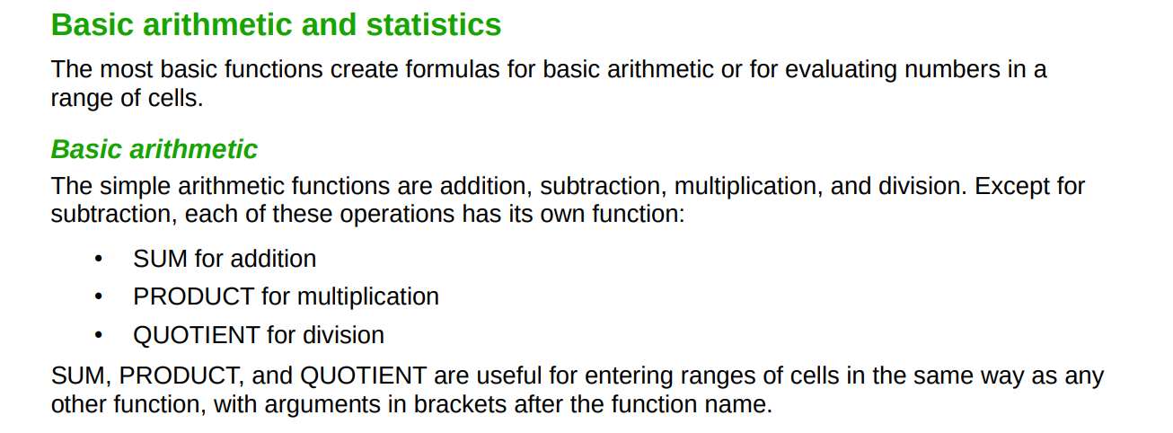

Slide 18
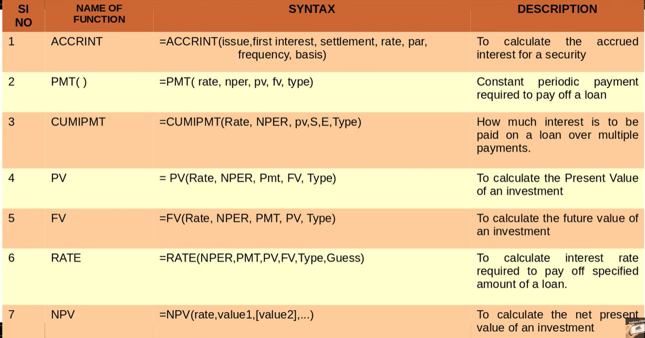

Slide 19
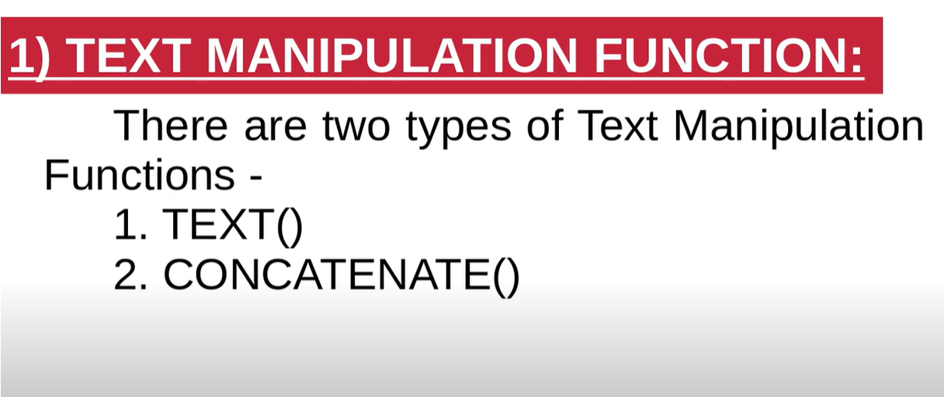

Slide 20
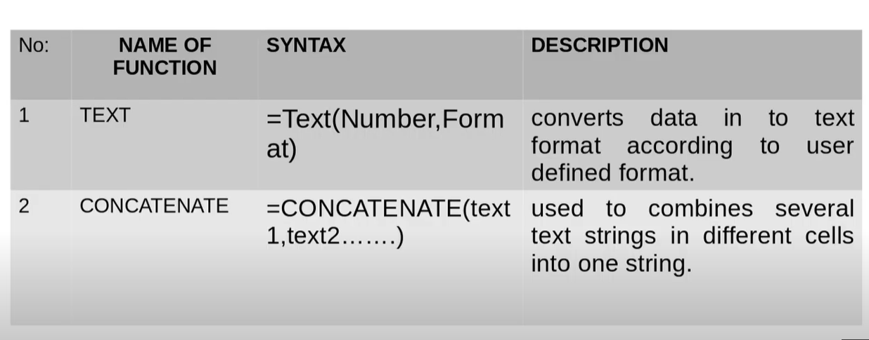

Slide 21
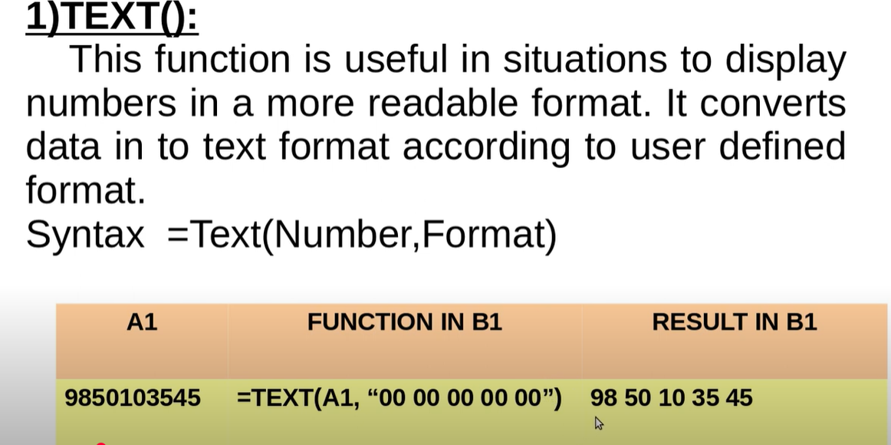

Slide 22
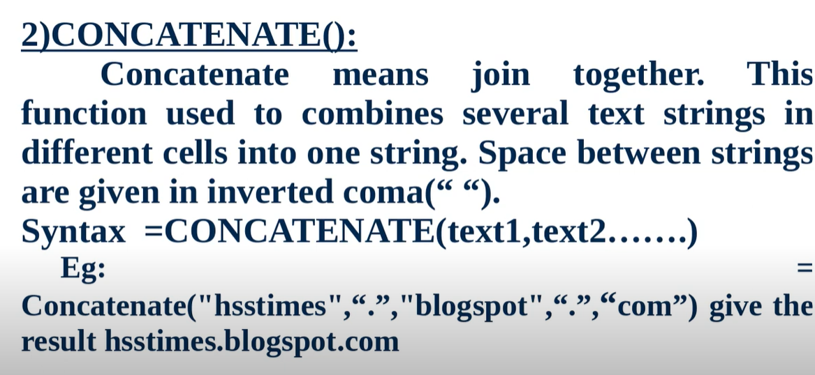
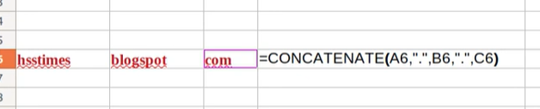

Slide 23
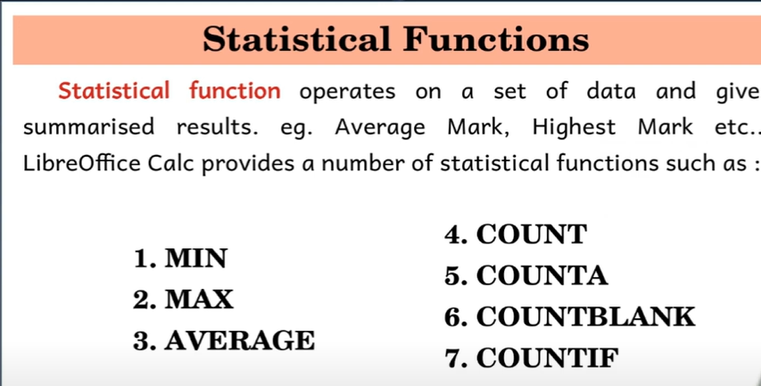

Slide 24
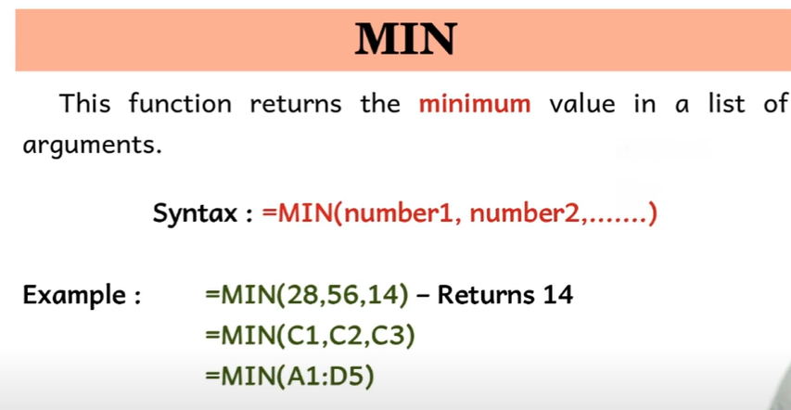

Slide 25
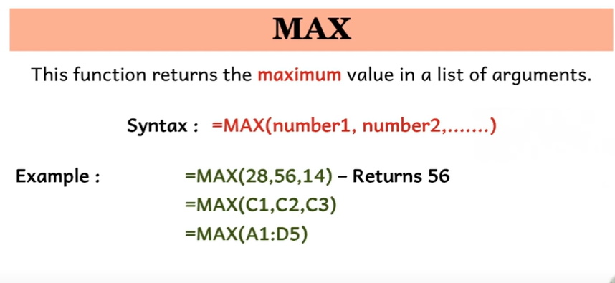

Slide 26
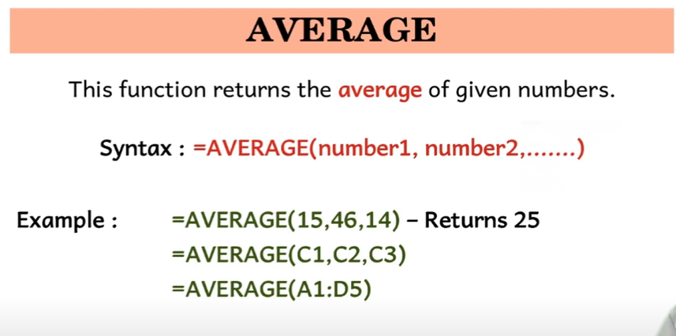

Slide 27
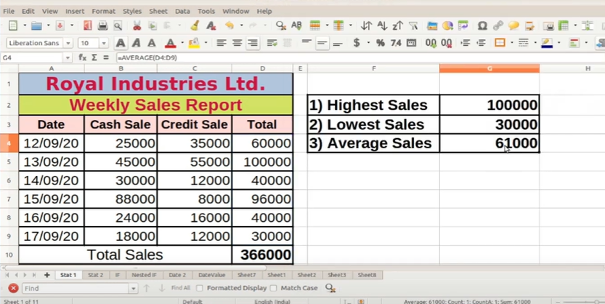

Slide 28
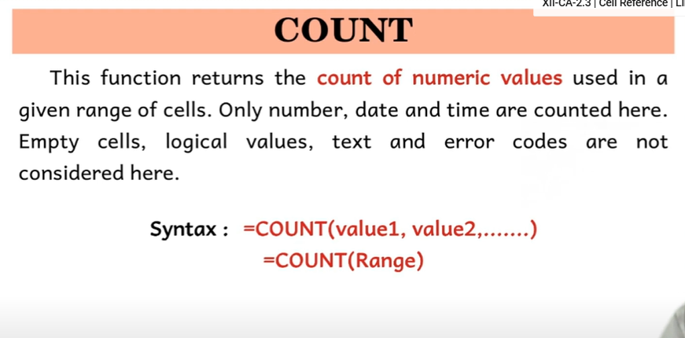

Slide 29
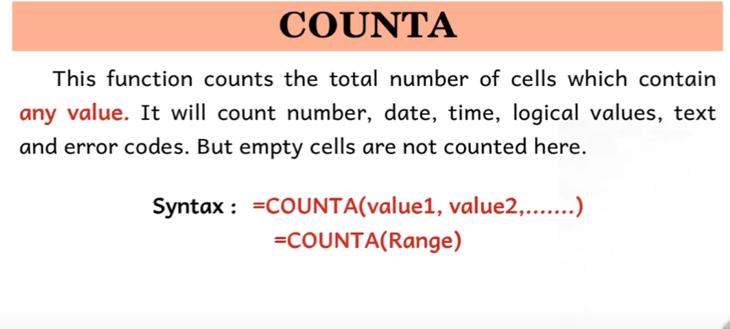

Slide 30
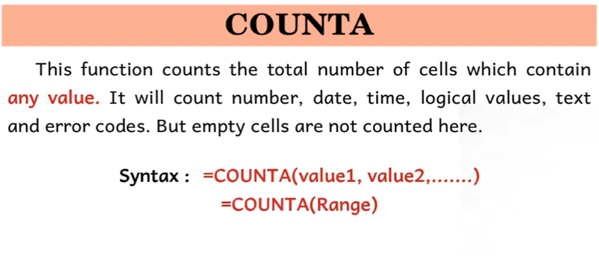

Slide 31
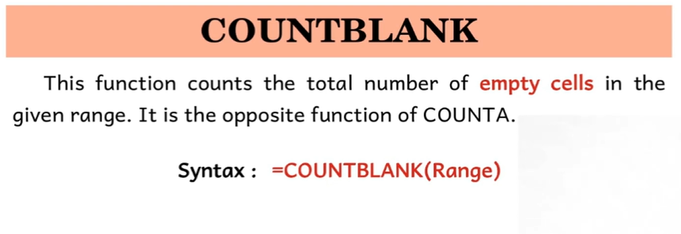

Slide 32
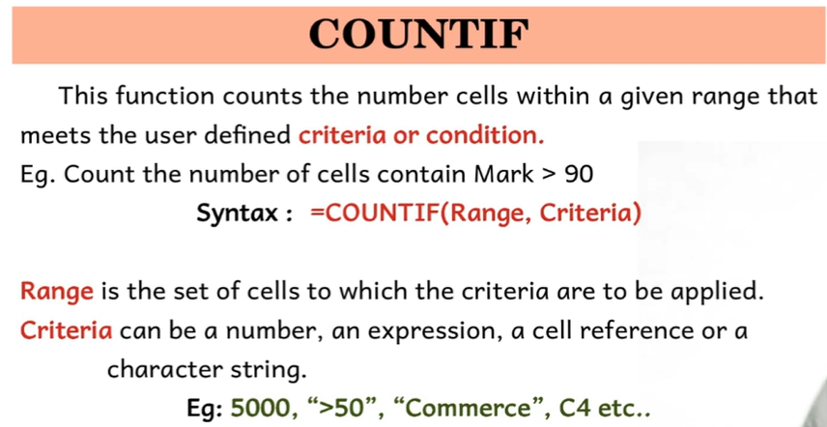

Slide 33
